Slide 1

Sports Analytics II
Produced by Dr. Mario
UNC STOR 390

Slide 2

Data Management
Different Sources: What are some examples?
Quantitative and Qualitative
Objective and Subjective
Text and Images and Video
Increasing Number of Sources
Increasing Volume from Those Sources
Data Comes Structured and Unstructured
Structured is Easier to Analyze
Unstructured is More Flexible

Slide 3
Data Management
Process of Data Management
Standardization
Purpose: To Make Combining Data Easy
Know All Sources of Data in the Organization
Create a Data Inventory: Variable, Description, Format
Different Departments, but Same Format
Standardization
Centralization
Integration

Slide 4
Data Management
Centralization
Purpose: To Make Acquiring Data Easy
Stored and Protected in the Same Location
Accessible by All Decision Makers
Continual Assessment of Data Quality Via Multiple Eyes
Integration
Purpose: To Make Analyzing Data Easy
Merging/Linking Data According to Unique Identifiers
Examples: What Insights Could Be Learned?
Training Staff Data and Coaching Staff Data
Scouting Data and Play-by-Play Data
Marketing Data and Salary Data

Slide 5
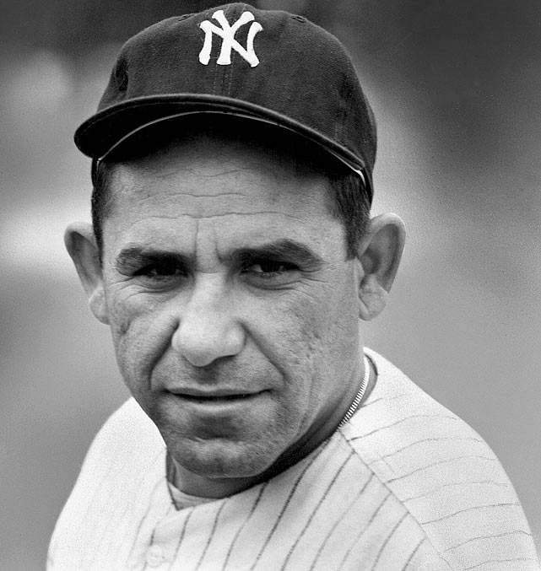
Analytic Models
Process of Predictive Analytics
Consider the Research Question or Problem
Identify or Create Dependent Variables of Interest
Incorporate All Information
Find Relationships (Linear/Nonlinear)
Evaluate Model, Report, and Repeat
Prediction is difficult,
especially about the future. -Yogi Berra

Slide 6
Analytic Models
Five Questions for All Analyses – Ben Alamar
What was the thought process that led to the analysis?
What is the context of the result?
How much uncertainty is in the analysis?
How does the result inform the decision-making process?
How can we further reduce the uncertainty?

Slide 7
What is Sports Analytics?
Information Systems
Mechanisms for Data Delivery
Organization and Presentation Matters
“One Version of the Truth” – Summarized and Centralized
Static: Automatically Generated Reports
Interactive: Computer, Phone, Tablet, and Web Applications

Slide 8
Analytics In the Organization
On-the-Field
Coaching
Player Development
Player Evaluation
Off-the-Field
Sales
Marketing
Cap Management
Hiring
Public Relations and Social Media

Slide 9
Analytics Across the Organizations
Sports Analytics Use Survey (2013)
Sample of 27 People (NFL, MLB, NBA, EPL)
How Many Different Sources?
1-2 (6.7%)
3-4 (33.3%)
5-6 (13.3%)
>6 (46.71%)

Slide 10
Analytics Across the Organizations
How Much Data is Centralized?
All (31.3%)
Most (37.4%)
Some (31.3%)
How Much Data is Dependent on One Person?
Some (50.0%)
Most (43.7%)
All Data Centralized (6.3%)

Slide 11
Analytics Across the Organizations
Is Data Checked for Errors?
Always (31.3%)
Usually (37.5%)
Sometimes (18.8%)
Occasionally (6.1%)
Rarely (6.3%)
How Many Database Programmers are Employed?
0 (37.5%)
1-2 (50.0%)
3-4 (0.0%)
>5 (12.5%)

Slide 12
Analytics Across the Organizations
How Many Statistical Analysts are Employed?
0 (20.0%)
1-2 (66.6%)
3-4 (0.0%)
>5 (13.3%)
Roadblock: Difficulty Identifying Strong Applicant
Difficulty in Both Hiring and Evaluating

Slide 13
Analytics Across the Organizations
Clear Process for Hiring/Evaluating Analysts
Strongly Agree (13.3%/14.3%)
Somewhat Agree (13.3%/14.3%)
Neutral (26.7%/28.6%)
Somewhat Disagree (13.4%/21.4%)
Strongly Disagree (33.3%/21.4%)
Analytic Resources in Line with Strategic Game Plan
Strongly Agree (26.7%)
Somewhat Agree (33.3%)
Neutral (33.3%)
Strongly Disagree (6.7%)

Slide 14
Data Management
Process
dafd

Slide 15
Final Inspiration
I am not cocky. I am 95% confident.
- Mahatma Mario

